Slide 1
Simulation
examples

Slide 2
Example А Growing vegetables
Deterministic business model

Slide 3
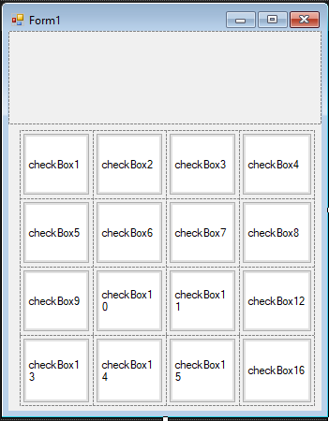
Example А
Business model:
click – start to grow / cut vegetables
Stages:
TableLayoutPanel
Empty
CheckBox
Apperiance=Button
Start growing
Plant shoots
Nearby mature
Mature
Rotten

Slide 4
Example A Click on checkbox
private void checkBox1_CheckedChanged(object sender, EventArgs e)
{
CheckBox cb = (sender as CheckBox);
if (cb.Checked) StartGrow(cb);
else Cut(cb);
}
private void Cut(CheckBox cb)
{
cb.BackColor=Color.White;
}
private void StartGrow(CheckBox cb)
{
cb.BackColor=Color.Black;
}

Slide 5
Example A Adding timer
private void timer1_Tick(object sender, EventArgs e)
{
foreach(CheckBox cb in tableLayoutPanel1.Controls)
{
if (cb.BackColor == Color.Black) cb.BackColor = Color.Green;
else if (cb.BackColor == Color.Green) cb.BackColor = Color.Yellow;
else if (cb.BackColor == Color.Yellow) cb.BackColor = Color.Red;
else if (cb.BackColor == Color.Red) cb.BackColor = Color.Brown;
}
}

Slide 6
Example A Using business model
enum CellState
{
Empty,
Growing,
Green,
Yellow,
Red,
Overgrow
}

Slide 7
Example A Cell class
class Cell
{
public CellState state = CellState.Empty;
public void NextState()
{
if ((state != CellState.Overgrow) && (state != CellState.Empty)) state++;
}
internal void StartGrow()
{
state++;
}
internal void Cut()
{
state = CellState.Empty;
}
}

Slide 8
Example A Field
public partial class Form1 : Form
{
Dictionary<CheckBox, Cell> field = new Dictionary<CheckBox, Cell>();
public Form1()
{
InitializeComponent();
foreach (CheckBox cb in tableLayoutPanel1.Controls)
field.Add(cb, new Cell());
}

Slide 9
Example A New methods
private void Cut(CheckBox cb)
{
field[cb].Cut();
UpdateBox(cb);
}
private void StartGrow(CheckBox cb)
{
field[cb].StartGrow();
UpdateBox(cb);
}
private void timer1_Tick(object sender, EventArgs e)
{
foreach(CheckBox cb in tableLayoutPanel1.Controls)
{
field[cb].NextState();
UpdateBox(cb);
}
}

Slide 10
Example A New methods
private void UpdateBox(CheckBox cb)
{
Color c = Color.White;
switch (field[cb].state)
{
case CellState.Growing: c = Color.Black;
break;
case CellState.Green: c = Color.Green;
break;
case CellState.Yellow: c = Color.Yellow;
break;
case CellState.Red: c = Color.Red;
break;
case CellState.Overgrow: c = Color.Brown;
break;
}
cb.BackColor = c;
}

Slide 11
Example A Time slot
private void timer1_Tick(object sender, EventArgs e)
{
foreach(CheckBox cb in tableLayoutPanel1.Controls)
{
field[cb].NextState();
UpdateBox(cb);
}
}
Step

Slide 12
Example A Cell class
class Cell
{
internal void StartGrow()
{
state++;
}
internal void Cut()
{
state = CellState.Empty;
progress = 0;
}

Slide 13
Example A Cell class
internal void Step()
{
if ((state != CellState.Overgrow) && (state != CellState.Empty))
{
progress++;
if (progress < prGrowing) state = CellState.Growing;
else if (progress < prGreen) state = CellState.Green;
else if (progress < prYellow) state = CellState.Yellow;
else if (progress < prRed) state = CellState.Red;
else state = CellState.Overgrow;
}
}
const int prGrowing = 20;
const int prGreen = 60;
const int prYellow = 80;
const int prRed = 100;

Slide 14
Example A Using property (Cell class)
public CellState state
{
get
{
if (progress == 0) return CellState.Empty;
if (progress < prGrowing) return CellState.Growing;
else if (progress < prGreen) return CellState.Green;
else if (progress < prYellow) return CellState.Yellow;
else if (progress < prRed) return CellState.Red;
else return CellState.Overgrow;
}
}
private int progress = 0;
internal void StartGrow()
{
progress++;
}
internal void Cut()
{
progress = 0;
}
internal void Step()
{
if ((state != CellState.Overgrow) && (state != CellState.Empty))
progress++;
}

Slide 15
Example A Showing date (Form1 class)
int day = 0;
private void timer1_Tick(object sender, EventArgs e)
{
foreach(CheckBox cb in tableLayoutPanel1.Controls)
{
field[cb].Step();
UpdateBox(cb);
}
day++;
labDay.Text = "Day: " + day;
}

Slide 16
Laboratory #1
Assignments:
Add economics
Add speed controls

